Slide 1
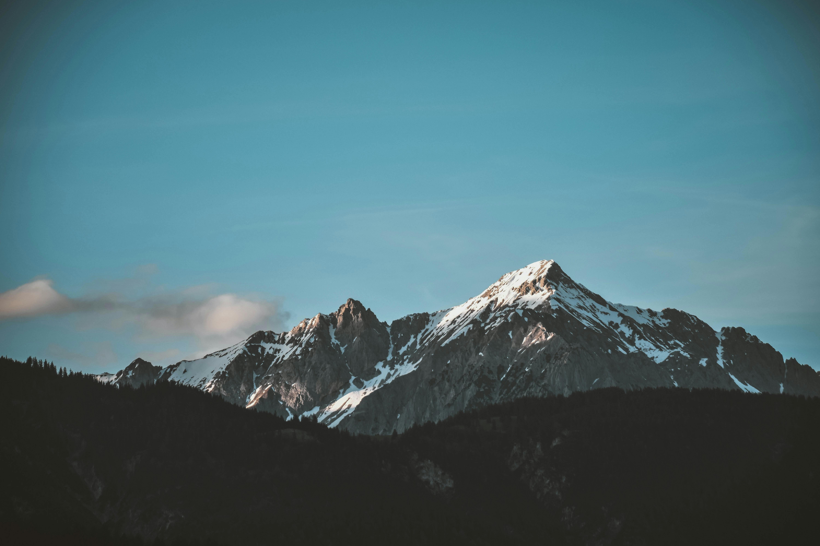
Group 11

Slide 2
Hiking Weather App

Slide 3
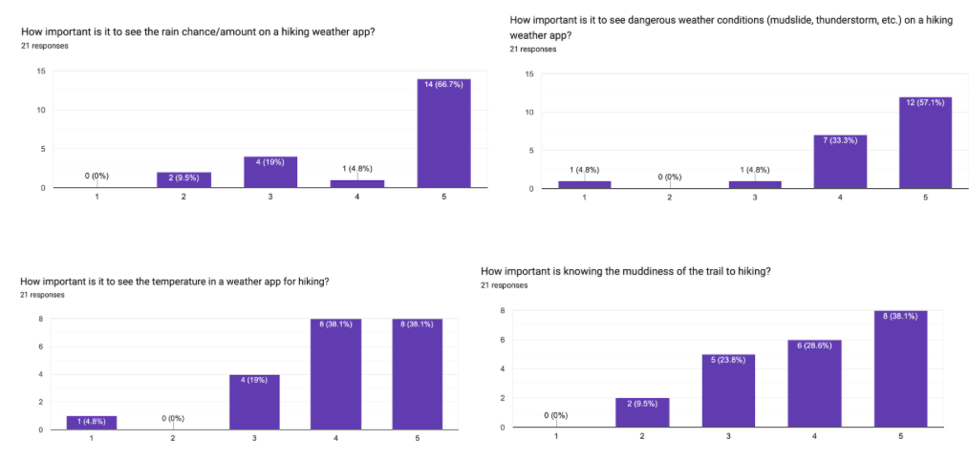
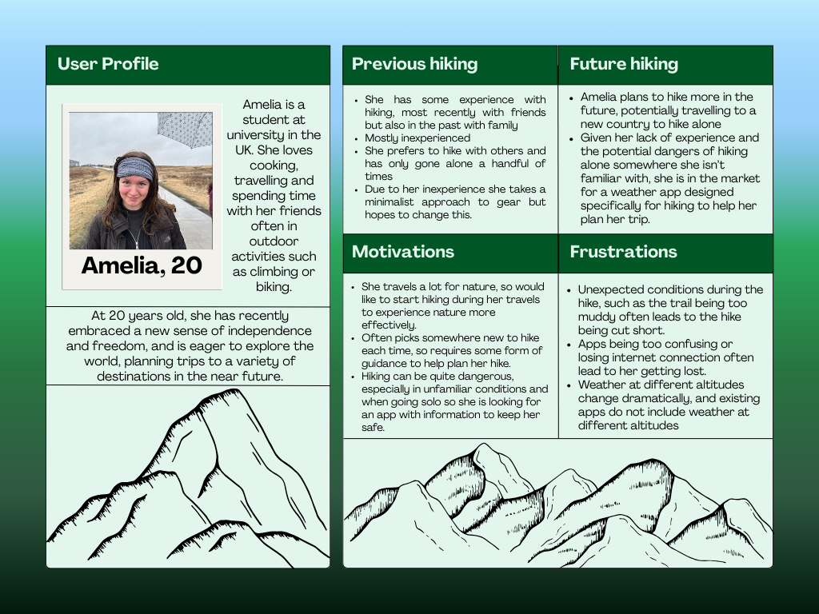
User Research
Exploratory mixed method research
Focus group -> Tailored questionnaire
Results collated into tables/graphs
Persona from User Research

Slide 4
Target User Groups
Primary:
Beginner hikers
Experienced hikers
Secondary:
People who may not have the app installed but will view it through a friend’s phone
Mountain Rescue

Slide 5


Searching

Slide 6

Changing Altitude

Slide 7

Changing Backgrounds

Slide 8

Planning Page

Slide 9

Detailed Page

Slide 10

Changing Altitude
Detailed Page:

Slide 11

Recent History

Slide 12
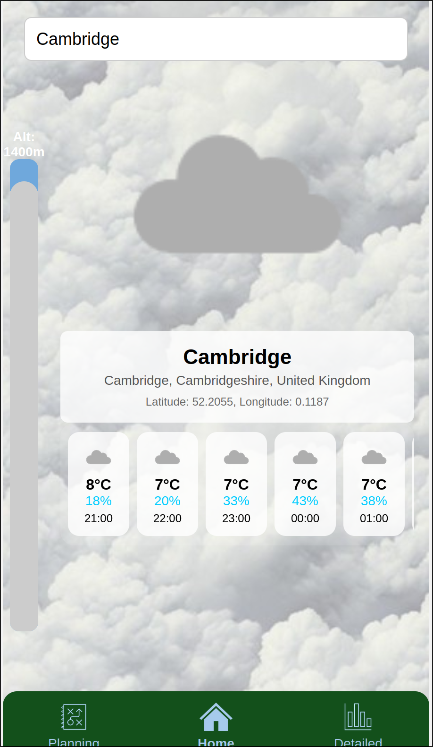
Limitations and Future Improvements
Altitude slider’s range does not adjust dynamically based on the location selected.
No offline mode
Limited API calls

